Slide 1



Chartered
Accountancy
What's it all about?

Slide 2

WHO IS CHARTERED ACCOUNTANTS IRELAND?
Ireland’s largest and longest established professional accounting education & membership body
Awards the prestigious ‘ACA’ designation - a globally recognised business leadership credential
Educating, supporting, advising – community relationship fostered, a lifelong career partner
Leading voice of the accounting profession and the island’s business community, supporting economic prosperity
All island body with Belfast and Dublin offices and education facilities – local, accessible
Partner to island’s
top employers
29,000 MEMBERS
7,000 STUDENTS

Slide 3


BECOMING A CHARTERED ACCOUNTANT IS YOUR PASSPORT TO…
CAREER CHOICE
& STABILITY
TRAVEL &
INTERNATIONAL WORK
A CONNECTED
COMMUNITY
BEST IN CLASS PROFESSIONAL
EDUCATION

Slide 4

CAREER CHOICE & STABILITY
Professional education developing skills to shape you as a:
Business leader
Critical thinker
Decision maker
Problem solver
Trusted advisor
Strategist
Influencer
Have options of working in any sector… practice, business, public, third level
Develop a varied career in traditional and non-traditional roles
Chartered Accountants work at senior levels across the market
Enjoy job security – 99% Employment
Earn a top salary £€
Business Leadership Qualification:
65% work in business, 25% work in practice

Slide 5







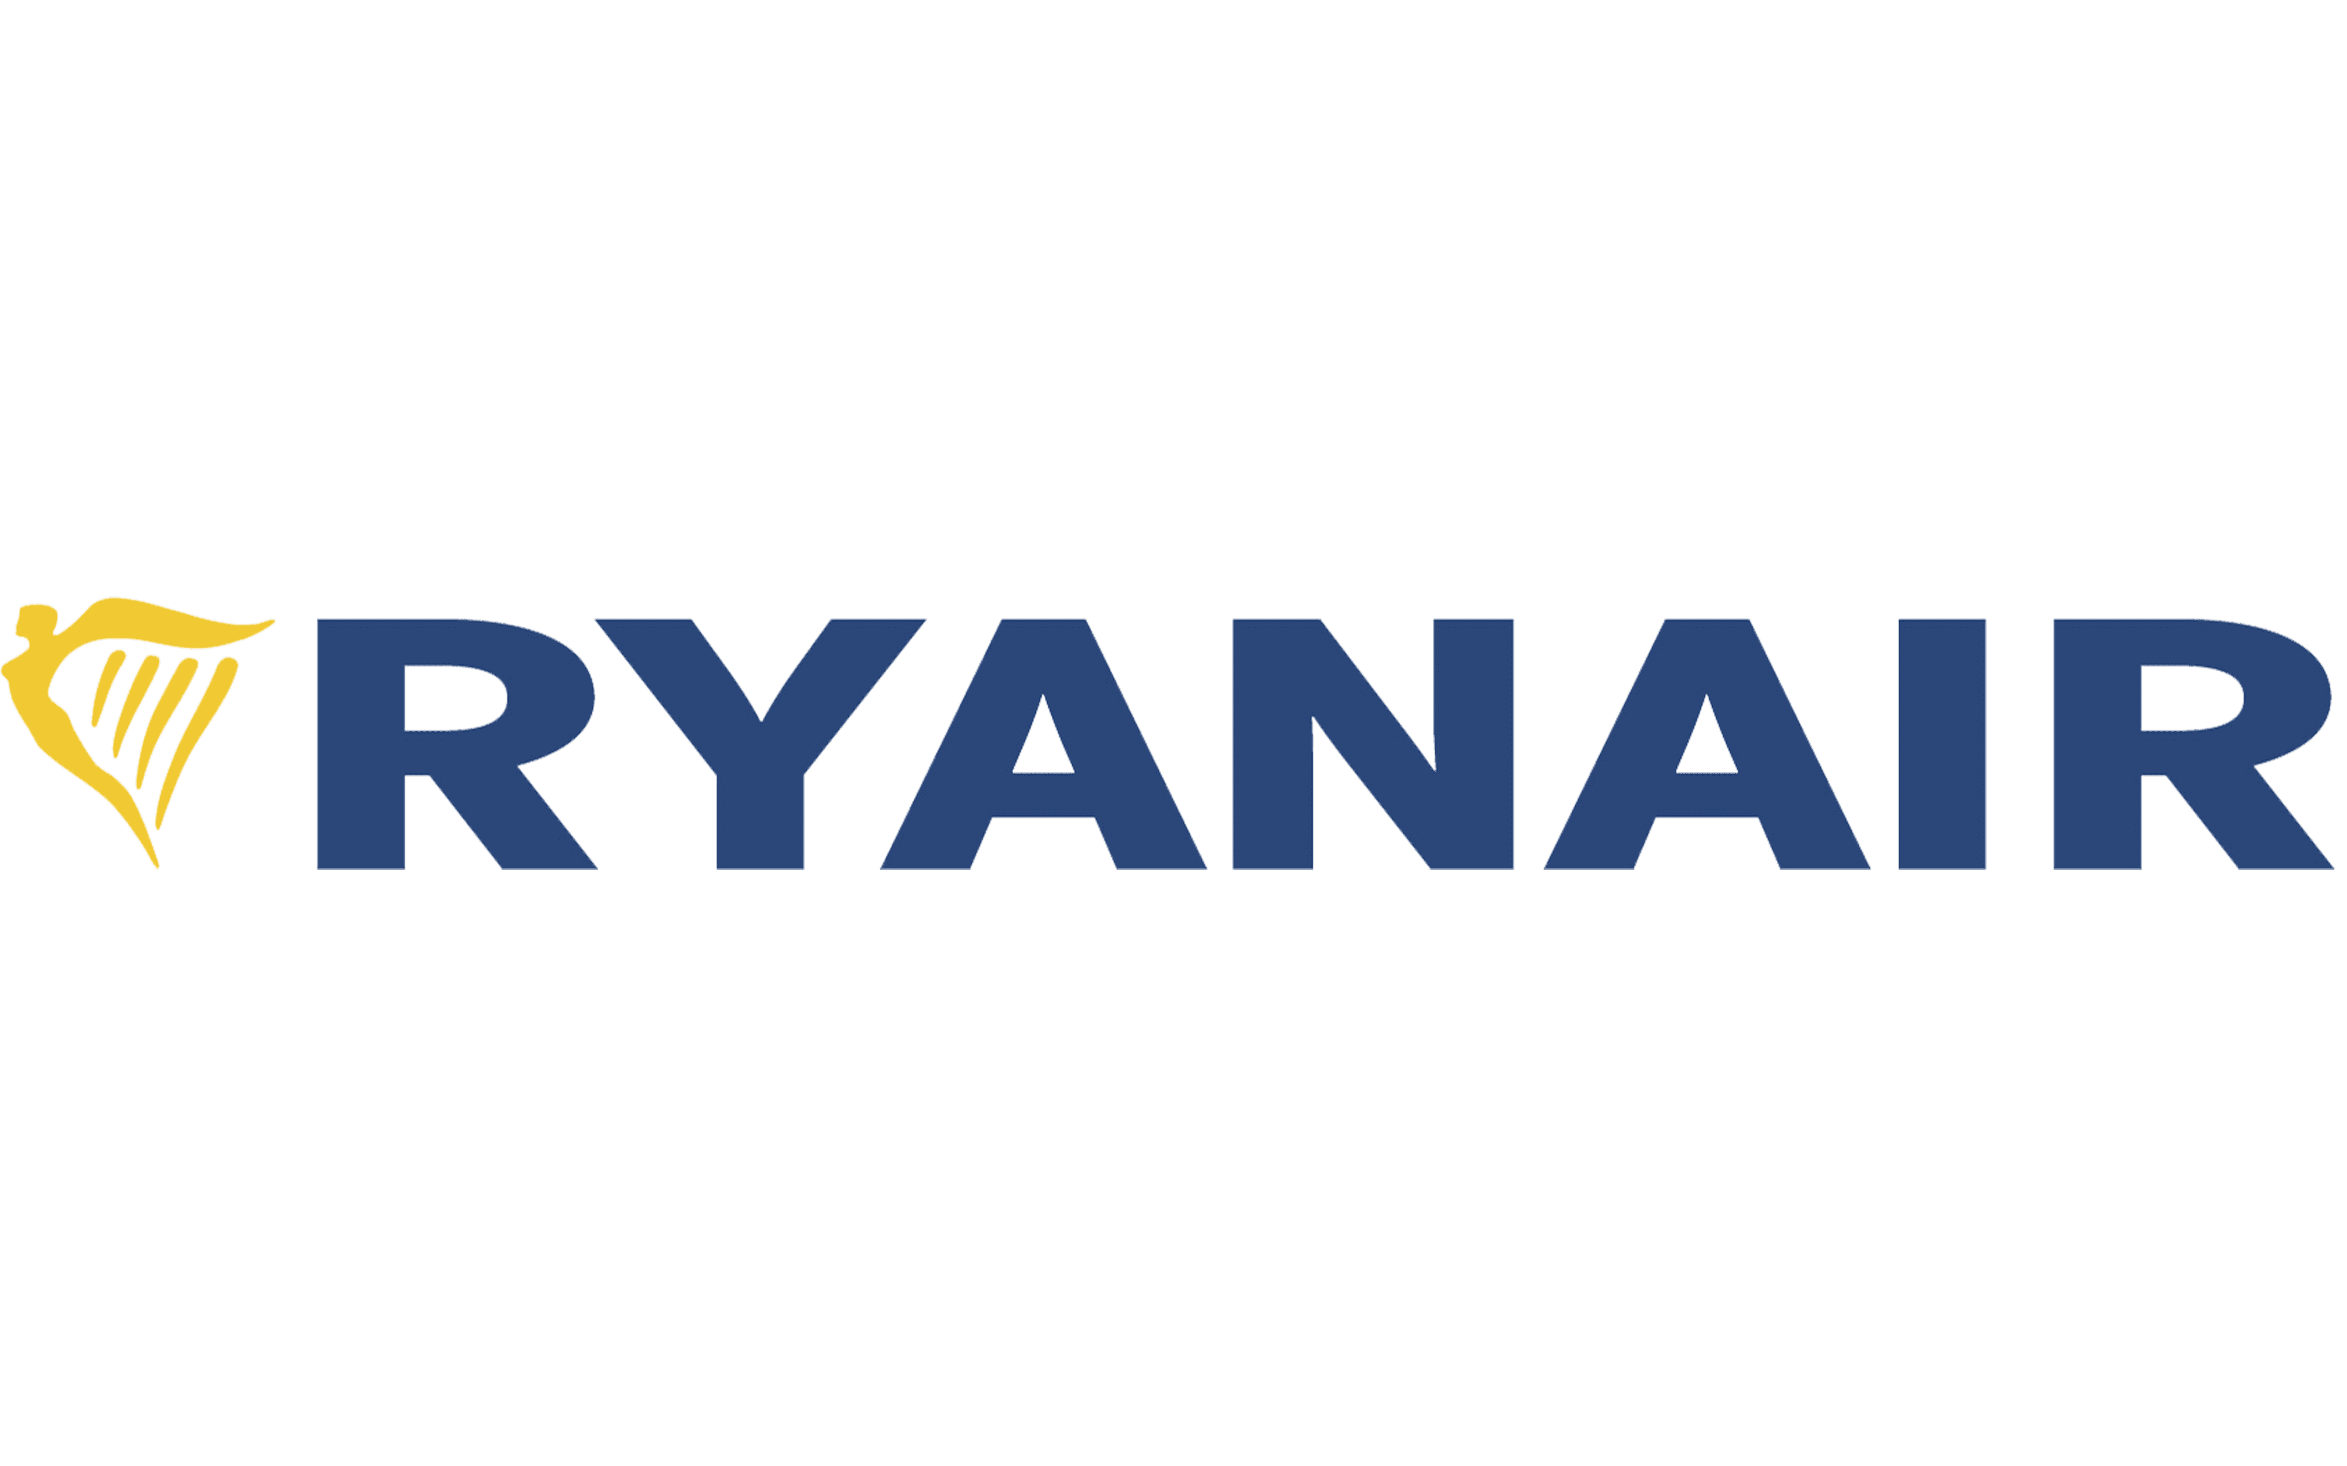



















CAREER CHOICE & STABILITY
We are partner to leading employers and the island’s largest recruiters of top talent
Practice
Public/Third Sector
Business
Along with many more!

Slide 6


TRAVEL & INTERNATIONAL WORK
15 professional bodies - representing over 700,000 members and over 1 million students
Globally recognised & respected professional qualification
Travel the world,
c.5000 work overseas
99 of 100 Best Global Brands employ Chartered Accountants
Chartered Accountants work in more than 200 countries worldwide
More than 50 of the FTSE 100 have a Chartered Accountant as CFO

Slide 7


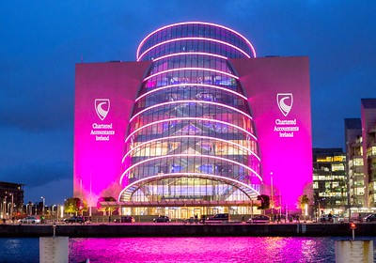

A CONNECTED COMMUNITY
Dedicated supports for students & members
29,000 members, 7,000 students
SDG and sustainability champions
Access to an exclusive business network & connected community of professionals
Student, district and international societies and sector groups
Lifelong career partner
Gender balance - 42% members & 47% students are female
Local all-island presence

Slide 8




Varied programme pathways and options including digital delivery & on demand learning
BEST IN CLASS PROFESSIONAL EDUCATION
Fresh content –
AI, RPA, data, emerging technologies
83% qualify
faster
Quality
inhouse
education
Continuous
review and
content refresh
Dedicated
student supports
Progressive tuition, modern syllabus - future proofing your skill development
Best
pass
rates
Fewer
exams
Exclusive technology partnerships:

Slide 9
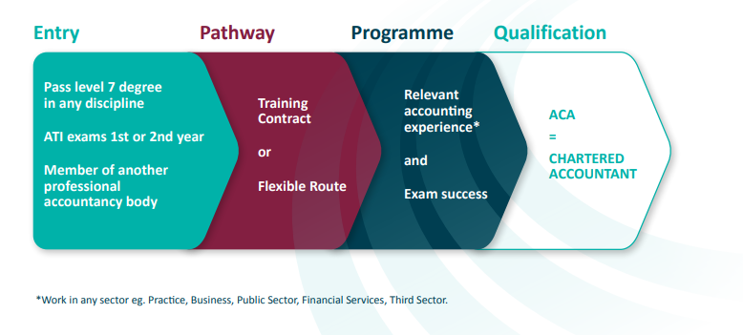
HOW DO I BECOME A CHARTERED ACCOUNTANT?
THE
ENTRY
ROUTES
AND
JOURNEY
OVERVIEW

Slide 10
ENTRY ROUTE 1: Graduate
Related Degrees:
Potential full / part exemptions
Undergrad degree (level 8) in:
  Accounting
  Finance
  Business
Postgrad Diploma in Accounting
Masters in Accounting
Non-Related Degrees:
Likely no exemptions
Undergrad degree (level 7/8) in ANY discipline:
  E.g. Law, Engineering, History, Marketing, Psychology, Art, English, Medicine, Computing
All backgrounds welcome
What's the difference? How many exams you sit on the Chartered programme
Previous related education history = potential exemptions!

Slide 11
ENTRY ROUTE 2: Accounting Technicians Ireland (ATI)
Apprenticeship pathway
Most popular with school leavers
Earn while you learn
2 year fixed programme
Work 4 days a week
College 1 day a week
On completion transition onto the Chartered ACA programme (potential exemptions)
Traditional pathway
Study with ATI for one year and gain a merit* – move onto the Chartered programme (no exemptions)
Study with ATI for two years to gain the full Accounting Technician qualification - then move onto the Chartered programme (potential exemptions)
* GCSE/A Level/Leaving Cert criteria to be met also
Accounting Technicians Ireland are a partner body of Chartered Accountants Ireland

Slide 12

THE ACA PROGRAMME & PATHWAYS
PATHWAYS TO QUALIFICATION:
TRAINING CONTRACT
  Employer led training journey
  Both education and work experience wrapped into an official training agreement with an employer
  Structured and consecutive approach
  Often connected to graduates schemes
2. FLEXIBLE ROUTE
  Student led training journey
  Education and work experience elements don’t need to run concurrently or consecutively
  Students can enrol independently
  Employers can be involved informally
  All students complete the same education programme and exams and undertake the same work experience requirement in both pathways
Education
Experience

Slide 13

EDUCATION JOURNEY
There are 3 levels of the ACA professional study/exam programme
How many levels you have to complete depends on your prior education and if you have come from a related subject background
(you may get exemptions from some)
The academic year for the course delivery runs annually from
Autumn – Spring/Summer
There are 2 exam sittings annually
- Summer & Autumn/Winter

Slide 14
THE ACA SYLLABUS / EXEMPTIONS
CAP 1
CAP 2
FAE
Financial Accounting
Finance
Management Accounting
Taxation I
Law for Accountants
(e-assessment)
Auditing & Assurance
Taxation II
Strategic Finance & Management Accounting
Financial Reporting
1. FAE Core
Integrated case study
(inc content on technologies, AI, data analytics)
2. FAE Elective
Choice of Audit, Tax, Advisory, Financial Services, Public Sector
ATI year 2 - partial
Honours (level 8) degrees in accounting, finance, etc with 2.2 grade – full/partial
Post-grad diplomas - full
Masters in Accounting - full
(9 recognised courses)
All students must
complete the FAEs
(no exemptions)

Slide 15
REALITY ≠ PERCEPTION
WORK EXPERIENCE JOURNEY
Students can gain the required professional development experience in any employer where they can access relevant accounting/finance work and where there is a qualified accountant to act as a mentor
CORE PROFESSIONAL VALUES*
BUSINESS
COMPETENCIES*
FUNCTIONAL
COMPETENCIES
Ethics & professionalism
Objectivity
Self-perception
Communication
Problem solving
Managing self & others
IT awareness
Project management
Stakeholder management
Financial reporting*
Audit & assurance
Management accounting
& finance
Strategic & business management
Taxation
*MANDATORY
PERIOD OF REQUIRED WORK EXPERIENCE:
4 years for ATI qualification holders
3.5 years for all Degree holders
3 years for accredited Postgraduate Diplomas and Masters holders

Slide 16





CHARTERED ACCOUNTANCY OVERVIEW
  Most prestigious
  Best education offering
  Fastest to qualify
  Fewer exams
  Highest pass rates
  Largest & connected network
  Global recognition
  High earning potential
  Job security
  Unrivalled & local support
ACA is your passport to a career of choice –
develop as a business leader & work in any sector
#BecomeACharteredAccountant

Slide 17

FIND OUT MORE…
For more on how you
can become a
Chartered Accountant:
  BecomeACharteredAccountant.Com
  info@charteredaccountants.ie
  @charteredaccirl_careers

