Slide 1
Chartered
Accountancy
What's it all about?

Slide 3
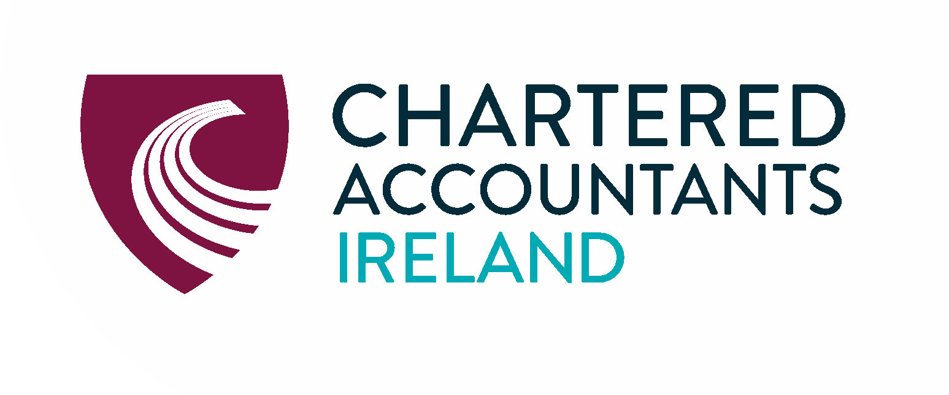
WHO IS CHARTERED ACCOUNTANTS IRELAND?
Ireland’s largest and longest established professional accounting education & membership body
Awards the prestigious ‘ACA’ designation - a globally recognised business leadership credential
Educating, supporting, advising – community relationship fostered, a lifelong career partner
Leading voice of the accounting profession and the island’s business community, supporting economic prosperity
All island body with Belfast and Dublin offices and education facilities – local, accessible
Partner to island’s
top employers
32,000 MEMBERS
7,000 STUDENTS

Slide 4
BECOMING A CHARTERED ACCOUNTANT IS YOUR PASSPORT TO…
CAREER CHOICE
& STABILITY
TRAVEL &
INTERNATIONAL WORK
A CONNECTED
COMMUNITY
BEST IN CLASS PROFESSIONAL
EDUCATION

Slide 5
CAREER CHOICE & STABILITY
Professional education developing skills to shape you as a:
Business leader
Critical thinker
Decision maker
Problem solver
Trusted advisor
Strategist
Influencer
Have options of working in any sector… practice, business, public/third sector
Develop a varied career in traditional and non-traditional roles
Chartered Accountants work at senior levels across the market
Enjoy job security – 99% Employment
Earn a top salary £€
Business Leadership Qualification:
65% work in business, 25% work in practice

Slide 6
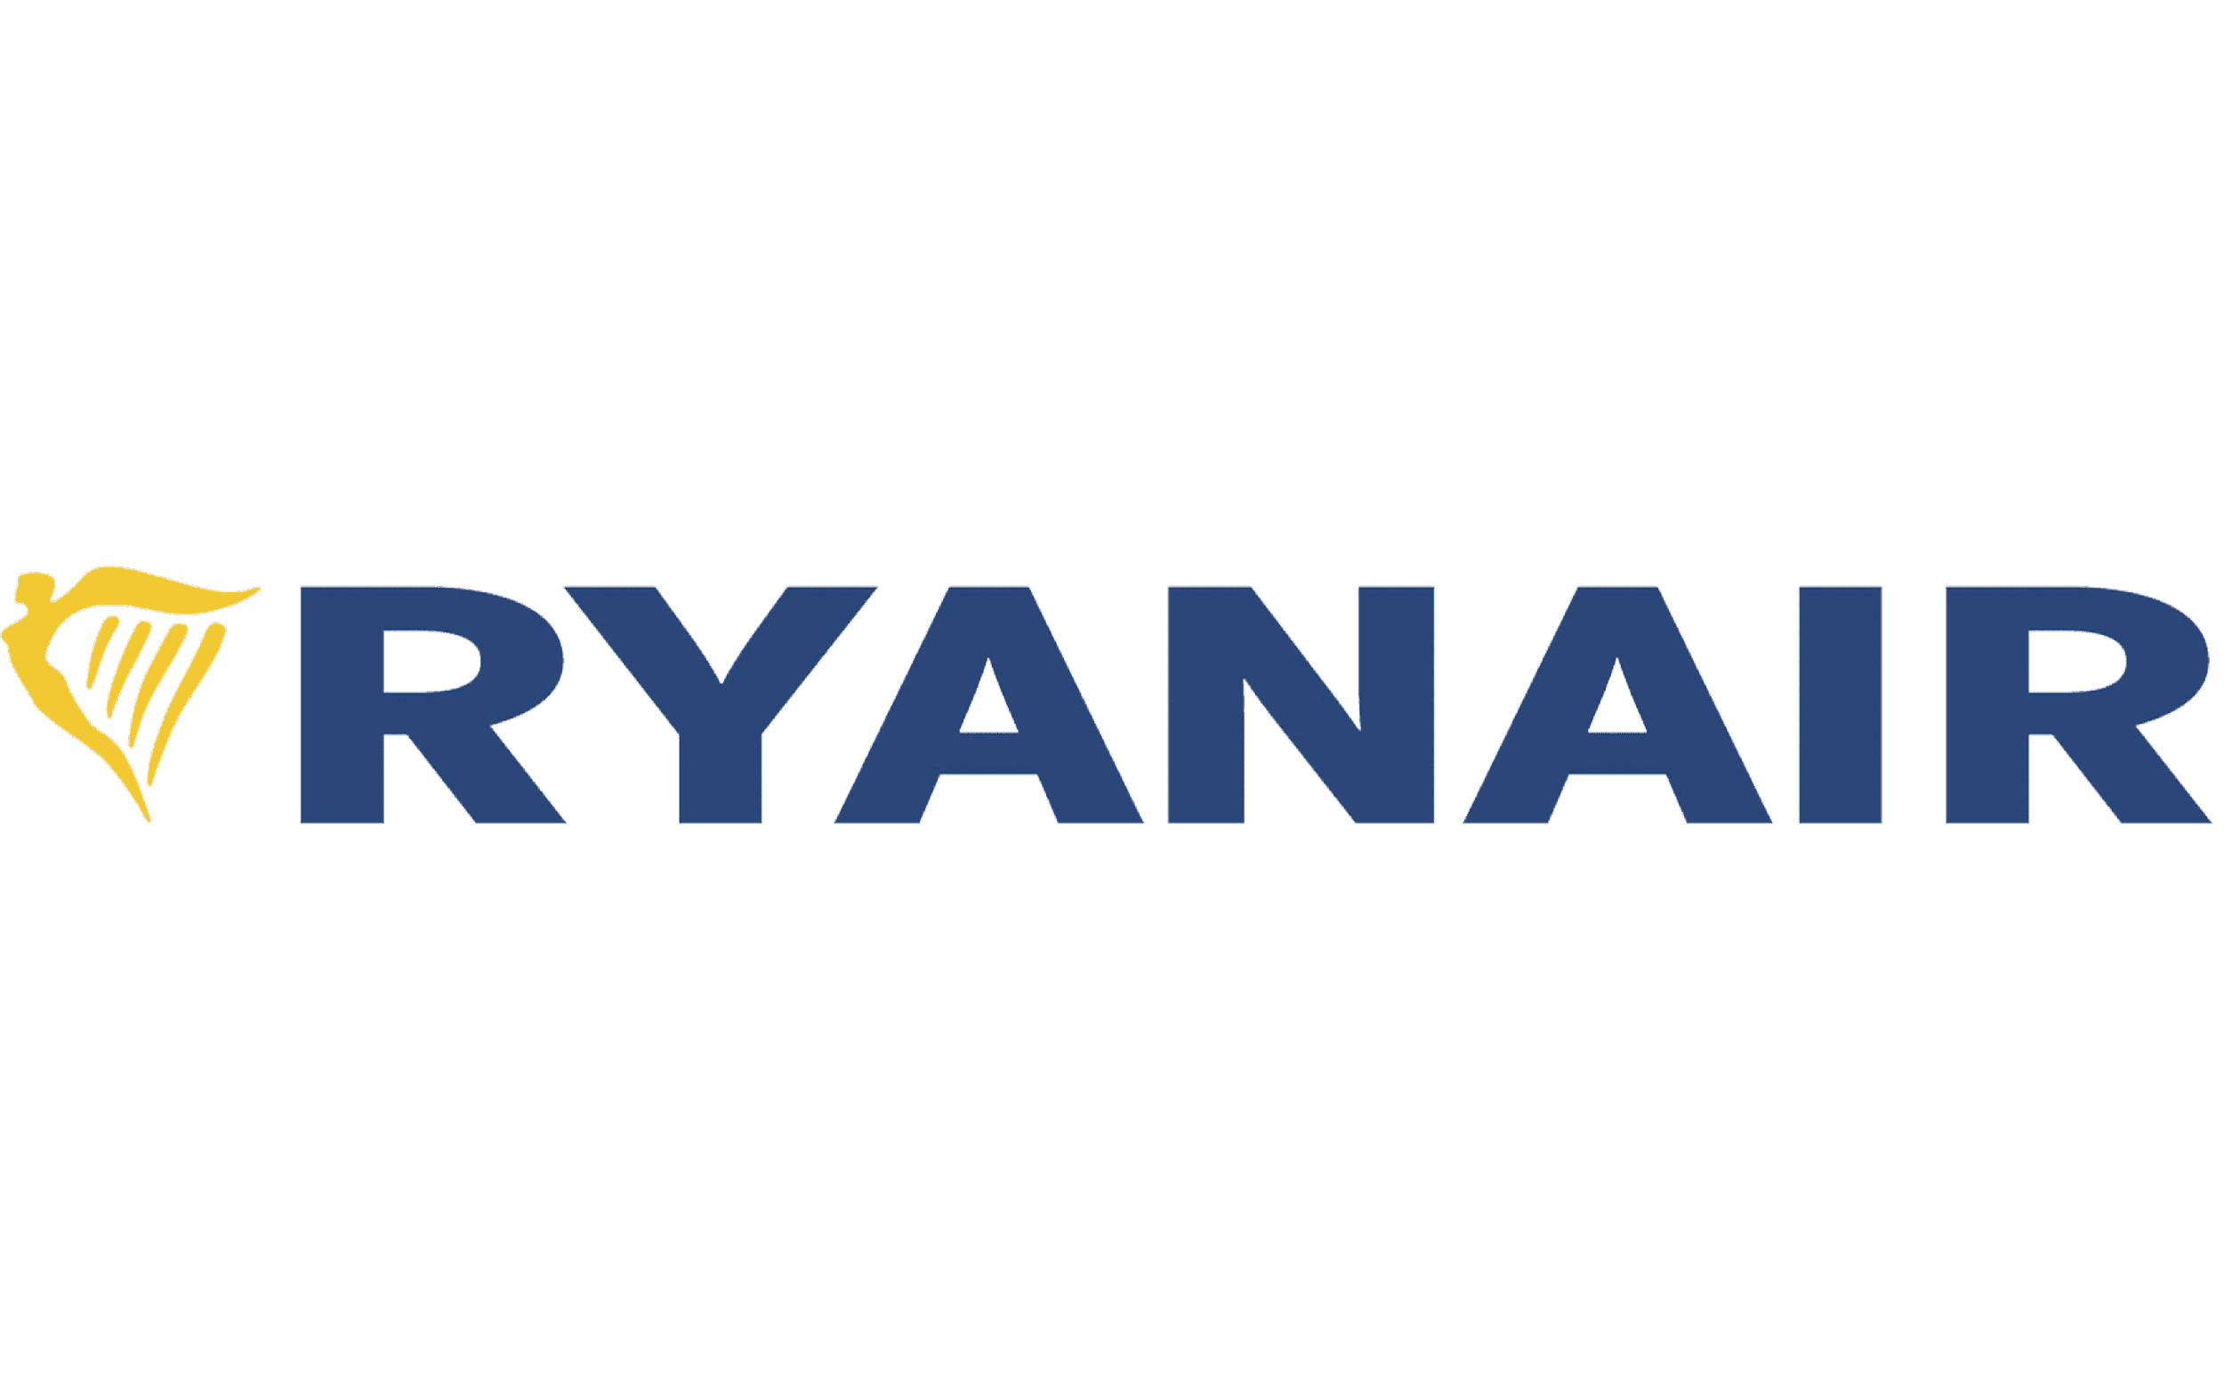
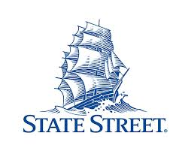
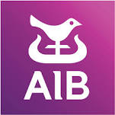
CAREER CHOICE & STABILITY
We are partner to leading employers and the island’s largest recruiters of top talent
Practice
Public/Third Sector
Business
Along with many more!

Slide 7
Varied programme pathways and options including digital delivery & on demand learning
BEST IN CLASS PROFESSIONAL EDUCATION
Fresh content – AI, RPA, data, emerging tech, sustainability
83% qualify
faster
Quality
inhouse
education
Continuous
review and
content refresh
Dedicated
student supports
Progressive tuition, modern syllabus - future proofing your skill development
Best
pass
rates
Fewer
exams
Exclusive technology partnerships:

Slide 8
TRAVEL & INTERNATIONAL WORK
15 professional bodies - representing over 700,000 members and over 1 million students
Globally recognised & respected professional qualification
Travel the world, c.5000 work overseas
99 of 100 Best Global Brands employ Chartered Accountants
Chartered Accountants work in more than 200 countries worldwide
More than 50 of the FTSE 100 have a Chartered Accountant as CFO

Slide 9
A CONNECTED COMMUNITY
Dedicated supports for students & members
Leading & largest body
Student societies
Access to an exclusive business network & connected community of professionals
District and international societies & special interest groups
Lifelong career partner
Gender balance - 42% members & 47% students are female
All-island presence

Slide 10
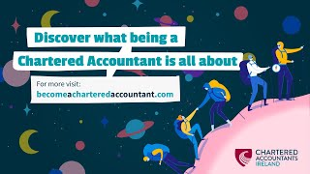

Slide 11
HOW DO I BECOME A CHARTERED ACCOUNTANT?
THE
ENTRY
ROUTES
AND
JOURNEY
OVERVIEW

Slide 12
ENTRY ROUTE 1: Graduate
Related Degrees:
Potential full / part exemptions
Undergrad degree (level 8) in:
Accounting
Finance
Business
Postgrad Diploma in Accounting
Masters in Accounting
Non-Related Degrees:
Likely no exemptions
Undergrad degree (level 7/8) in ANY discipline:
E.g. Law, Engineering, History, Marketing, Psychology, Art, English, Medicine, Computing
All backgrounds welcome
What's the difference? How many exams you sit on the Chartered programme Previous related education history = potential exemptions!

Slide 13
ENTRY ROUTE 2: Accounting Technicians Ireland (ATI)
Apprenticeship pathway
Most popular with school leavers
Earn while you learn
2 year fixed programme
Work 4 days a week
College 1 day a week
On completion transition onto the Chartered ACA programme
Potential for 3 exemptions at CAP1
Potential to apply for 1 year work experience credit
Traditional pathway
Study with ATI for one year and gain a merit* – move onto the Chartered programme (forego any exemptions)
Study with ATI for two years to gain the full Accounting Technician qualification - then move onto the Chartered programme
Potential for 3 exemptions at CAP1
* GCSE/A Level/Leaving Cert criteria to be met also
Accounting Technicians Ireland are a partner body of Chartered Accountants Ireland
Notes:
‹#›

Slide 14
THE ACA PROGRAMME & PATHWAYS
PATHWAYS TO QUALIFICATION:
TRAINING CONTRACT
3 way agreement – employer, student Institute
Employer sponsorship built in (ie. fee cover, work experience, study/exam leave all committed)
Student commitment is to fulfil training term with sponsoring employer
Structured and consecutive approach
Often connected to graduate schemes
2. FLEXIBLE ROUTE
Student led training journey
Students can enrol independently
No mandate for employer sponsorship but often support in background to varying degrees (not formally connected)
8 year window to complete programme & can complete programme levels on piecemeal basis except FAE
Education and work experience elements don’t need to run concurrently or consecutively
All students complete the same education programme and exams and undertake the same work experience requirement in both pathways – same qualification gained just completing the journey via different pathways!
Education
Experience
Notes:
‹#›

Slide 15
EDUCATION JOURNEY
There are 3 levels of the ACA professional study / exam programme
How many levels you have to complete depends on your prior education and if you have come from a related subject background
(you may get exemptions from some)
Virtual programme (both education delivery & exams) – after hours classes & self-directed learning
There are 2 online exam sittings annually -
Summer & Autumn/Winter
The academic year for the course delivery runs annually from Autumn – Spring/Summer
Earn & Learn / Work & Study Programme
Notes:
‹#›

Slide 16
THE ACA SYLLABUS / EXEMPTIONS
CAP 1
CAP 2
FAE
Financial Accounting
Finance
Management Accounting
Taxation I
Law for Accountants (e-assessment)
Auditing & Assurance
Taxation II
Strategic Finance & Management Accounting
Financial Reporting
1. FAE Core
Integrated case study (inc content on technologies, data analytics, sustainability)
2. FAE Elective
Choice of Audit, Tax, Advisory, Financial Services, Public Sector
ATI year 2 - partial
Honours (level 8) degrees in accounting, finance, etc with 2.2 grade – full/partial
Post-grad diplomas - full
Masters in Accounting - full
(9 recognised courses)
All students must
complete the FAEs
(no exemptions)

Slide 17
REALITY ≠ PERCEPTION
WORK EXPERIENCE JOURNEY
Students can gain the required professional development experience in any employer where they can access relevant accounting/finance work and where there is a qualified accountant to act as a mentor
CORE PROFESSIONAL VALUES*
BUSINESS
COMPETENCIES*
FUNCTIONAL
COMPETENCIES
Ethics & professionalism
Objectivity
Managing self & others
Communication
Problem solving
Strategic management
IT awareness
Project management
Stakeholder management
Legal performance
Financial reporting*
Audit & assurance
Taxation
Finance & Management accounting
IT/Systems
*MANDATORY
PERIOD OF REQUIRED WORK EXPERIENCE:
4 years for ATI qualification holders
3.5 years for all Degree holders
3 years for accredited Masters holders

Slide 18
CHARTERED ACCOUNTANCY OVERVIEW
Most prestigious
Best education offering
Fastest to qualify
Fewer exams
Highest pass rates
Largest & connected network
Global recognition
High earning potential
Job security
Unrivalled & local support
ACA is your passport to a career of choice –
develop as a business leader & work in any sector
#BecomeACharteredAccountant

Slide 19
FIND OUT MORE…
For more on how you can become a Chartered Accountant visit the links below:
www.BecomeACharteredAccountant.Com
info@charteredaccountants.ie
@charteredaccirl_careers

